Slide 1
Design and drawing for production
Open House

Slide 2
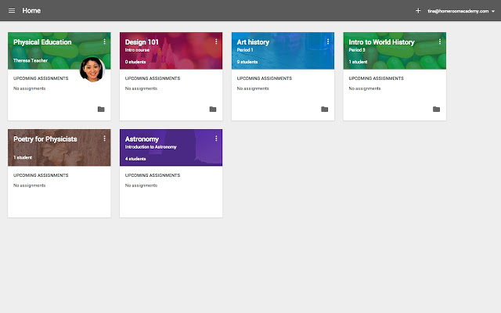
Google classroom

Slide 3
Curriculum objectives
Develop problem solving skills
Develop sketching, mechanical drawing, and computer aided drafting skills
Understand the importance of the design process
Evaluate problems in order to find a functional solution

